Slide 1

Discovering the Capacity & Resources Within:
Valuing the Experience of the Artist-Teacher
Travis Laughlin
Art Education Program Director
tlaughlin@joanmitchellfoundation.org
Saul Chernick
Professional Development Program Manager
schernick@joanmitchellfoundation.org
Antonia Perez
Artist-Teacher Peer Coach
aperez@joanmitchellfoundation.org

Slide 2
What do teaching artists have to offer?
Step 1: Find an image which represents the skills/knowledge/experiences that teaching artists bring.
Step 2: Find a partner.
Step 3: Share with your partner the image you chose and why.

Slide 3
The Joan Mitchell Foundation’s Art Education Program has incorporated the voice, experiences, and expertise of Artist-Teachers (ATs) into its Professional Development Program through:
- Peer led workshops
- Peer coaching
- Expanded leadership roles
- Curriculum resource guide created by
Artist-Teachers.
Notes:
*Intro selves; brief overview of JMF; OST!!!; AT vs TA!!!

Slide 4
Why did we do this?

Slide 5
Reasons:
• Scale and capacity
• An opportunity to hear from, and interact with, colleagues in new and different ways
• Recognize and value the expertise of senior AT staff
• Provide new avenues for professional growth
• Help staff see the “big picture” through an administrative lens
Notes:
At “Provide new avenues for professional growth” talk about annual reviews

Slide 6
Impact: Big Picture Perspective
“Being ‘behind the scenes’ has allowed me to learn more about the role of the administration. Sometimes as an AT I wasn't sure why certain decisions were being made, and now I see that decision making is a multi-layered process that often involves input from several individuals.”
-Natalie, Exhibition Coordinator
Notes:
For admins in the room, do you wish your TAs had this perspective

Slide 7
How did we determine who is qualified?

Slide 8
Criteria:
• Application process vs. internal selection
• Worked with us for at least two years
• High level of professionalism
• Strong communication and interpersonal skills
• Candidates advocate for themselves in writing
• Administrative team comes to a consensus
Notes:
Consensus can often mitigate accusations of favoritism-regardless, everyone shares responsibility for the decision.

Slide 9
Impact: Enhanced Professionalism
“I felt more ownership over my career. I improved my ability to meet deadlines which has affected my career as an artist as well as educator.”
-Rose, Newsletter Coordinator

Slide 10
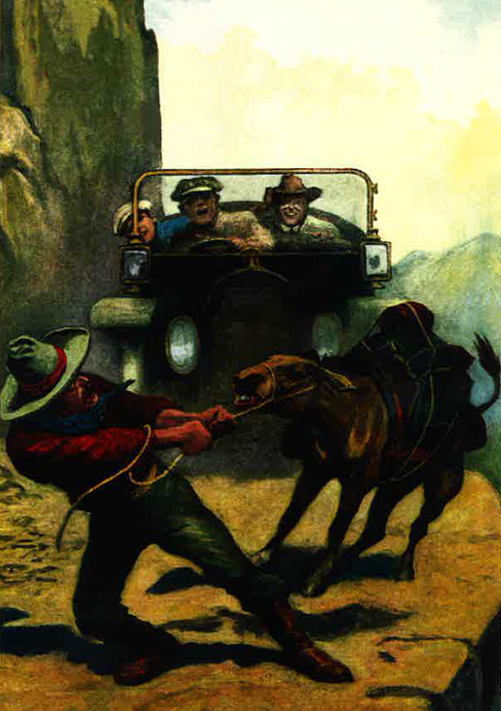
Notes:
Consensus can often mitigate accusations of favoritism-regardless, everyone shares responsibility for the decision.

Slide 11
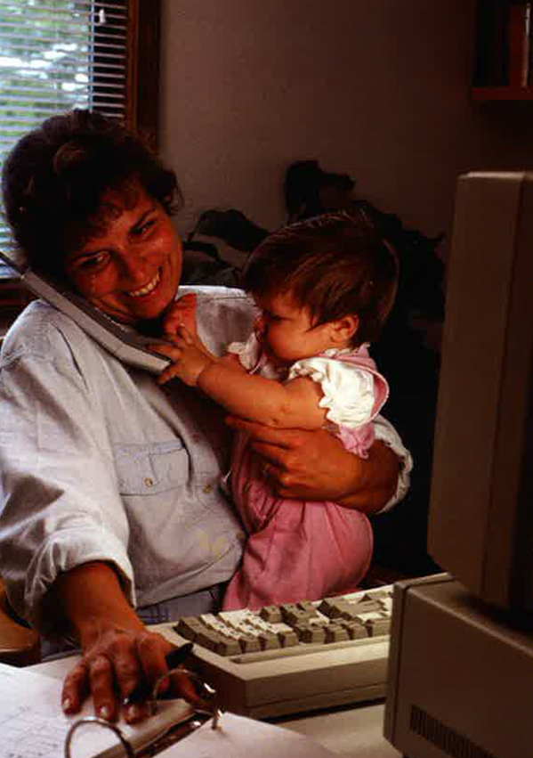
Notes:
Consensus can often mitigate accusations of favoritism-regardless, everyone shares responsibility for the decision.

Slide 12
What does it mean for our staff to shift?

Slide 13
Making the Transition:
• Artist Teachers Being Heard (Annual Reviews)
• Curriculum Planning Committee
• Peer Coach
• Working as Artists
• Straddling two camps (Peer and Admin)
Notes:
Consensus can often mitigate accusations of favoritism-regardless, everyone shares responsibility for the decision.

Slide 14
Impact: A sense of community
“Becoming a leader in a community I care so much about felt really great…[as if] the feelings I had towards the people I worked for were manifesting in a larger, more visible way.”
-Lauren, Site Liaison

Slide 15
What we Learned:
• Artist-Teachers often prefer to work with and hear from their peers rather than admin
• Application process leads to greater transparency
• Scaffolded support is required to ensure participants are successful:
- Schedule regular check-ins
- Closely supervise budgets and hours
- Proofing emails to peers & admin
- Coaching on how to work with peers
- Open and honest conversations with regards to expectations
- Annual reviews
• It is important that leadership roles last two or more years
• Peer-led workshops need oversight
- Feedback before and after
- Planning template
• There is a need for flexibility with time and budgets for large projects
• Important for Artist-Teachers in leadership roles to create systems/manuals to orient and train those who follow
• Allow the Artist-Teachers to inform how the role/project needs to adapt based on their experience
• Identify and celebrate transferable skills
Notes:
Consensus can often mitigate accusations of favoritism-regardless, everyone shares responsibility for the decision.

Slide 16
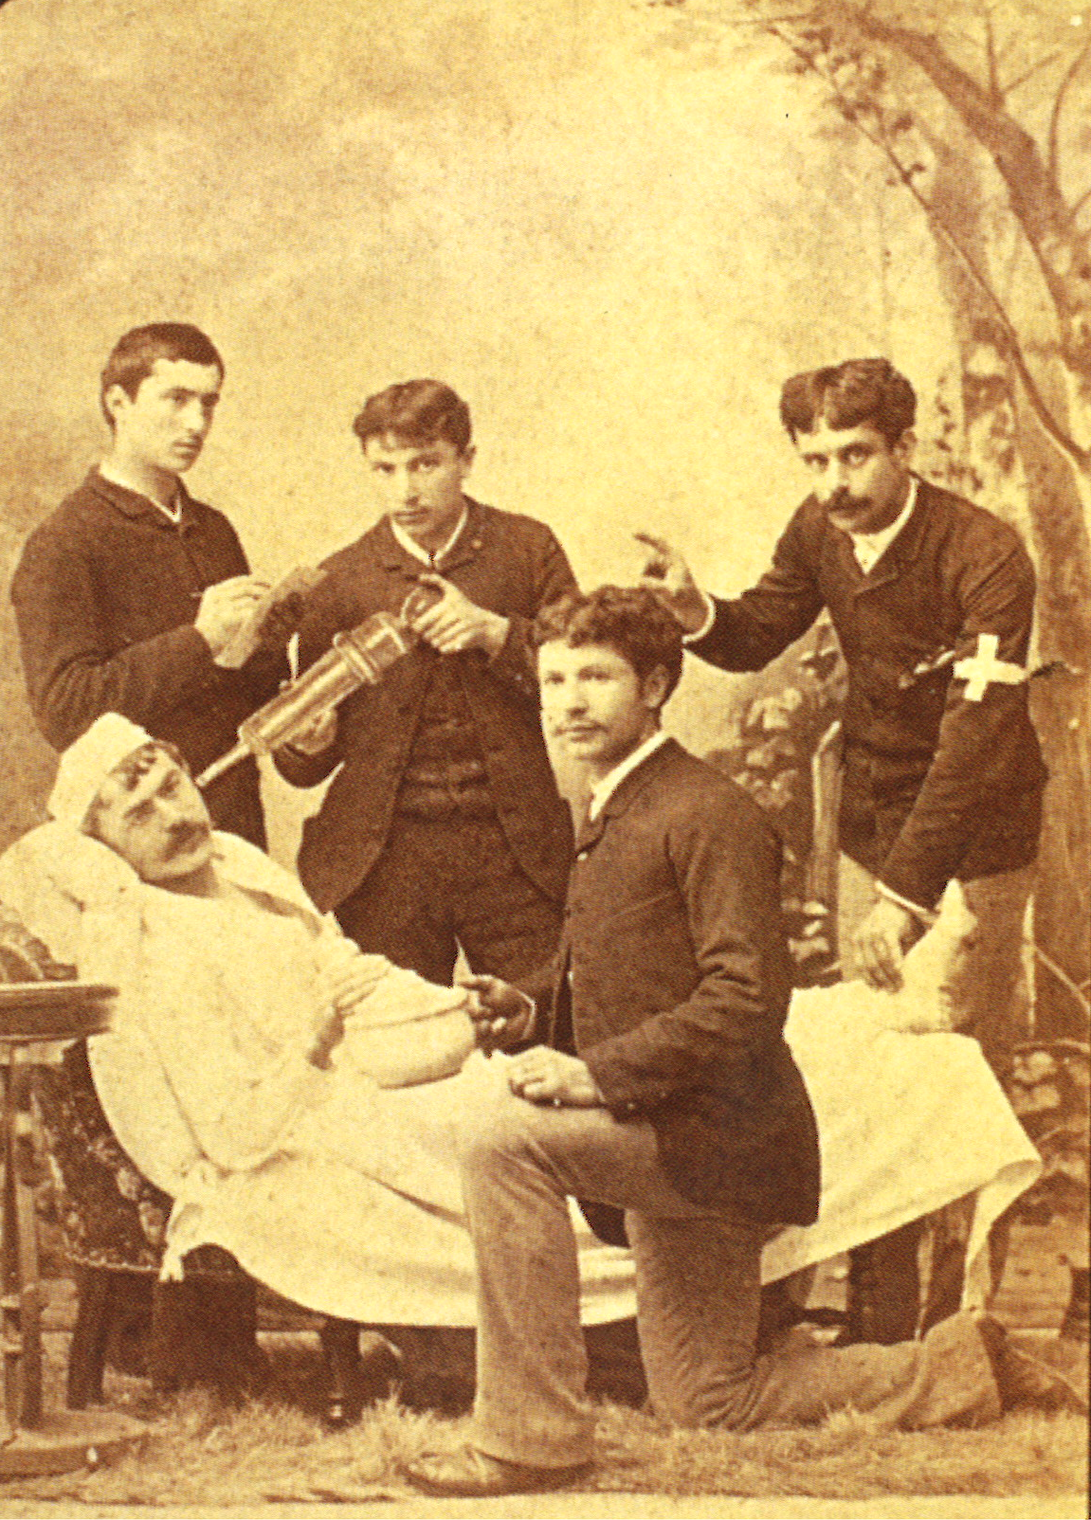
Notes:
Consensus can often mitigate accusations of favoritism-regardless, everyone shares responsibility for the decision.

