Slide 1
The Lullaby Project
Connecting Dreams with the People in Our Community

Slide 2
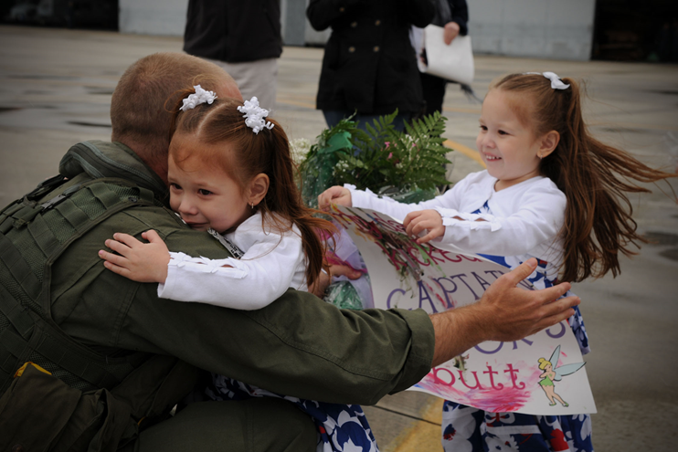
Notes:
My community now

Slide 3
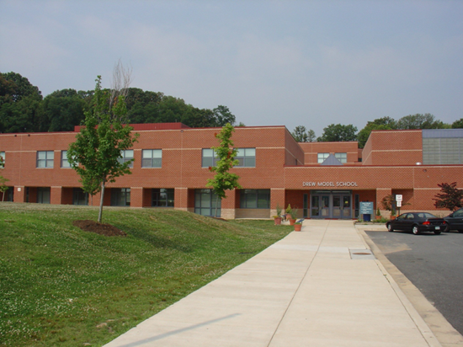
Drew Model Elementary School
Dr. Alice R. Hixson
Department of Defense Education Activity
Defense Dependents Elementary and Secondary Schools
Arlington Virginia Public Schools

Slide 4
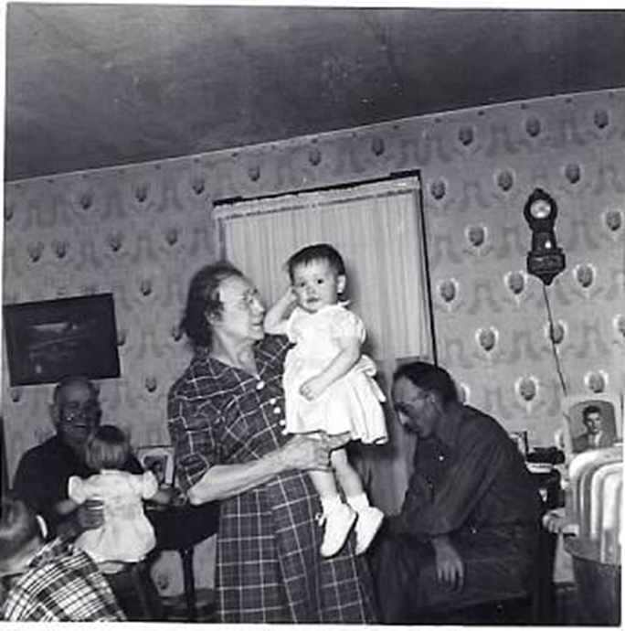

Slide 5
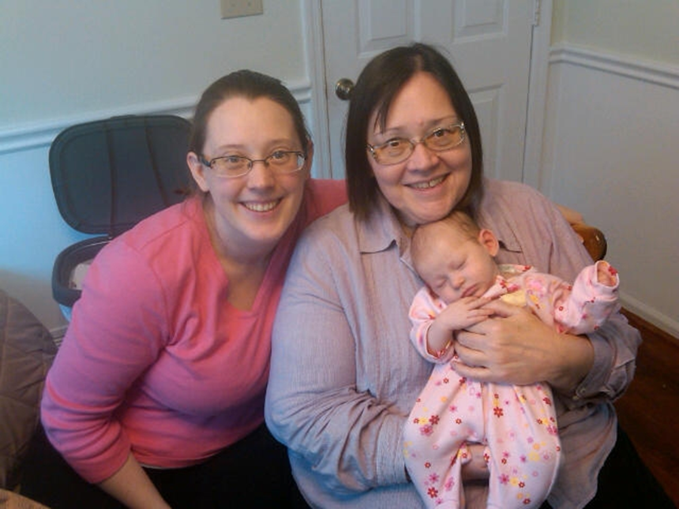
Notes:
Making a lullaby cd for every baby to remember Grandma Twinkie’s voice

Slide 6

Baby’s Boat

Slide 7
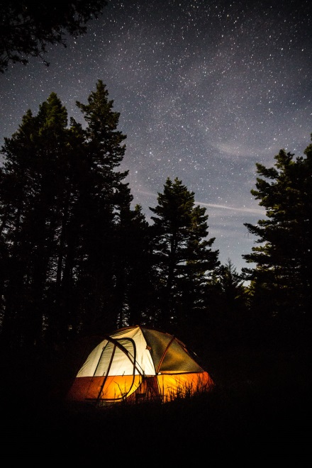
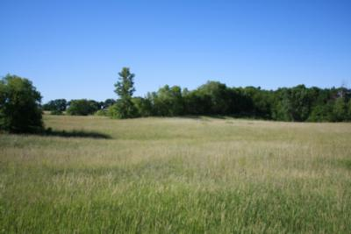
A Camp Woodland Lullaby
Good Night Girl Scouts

Slide 8
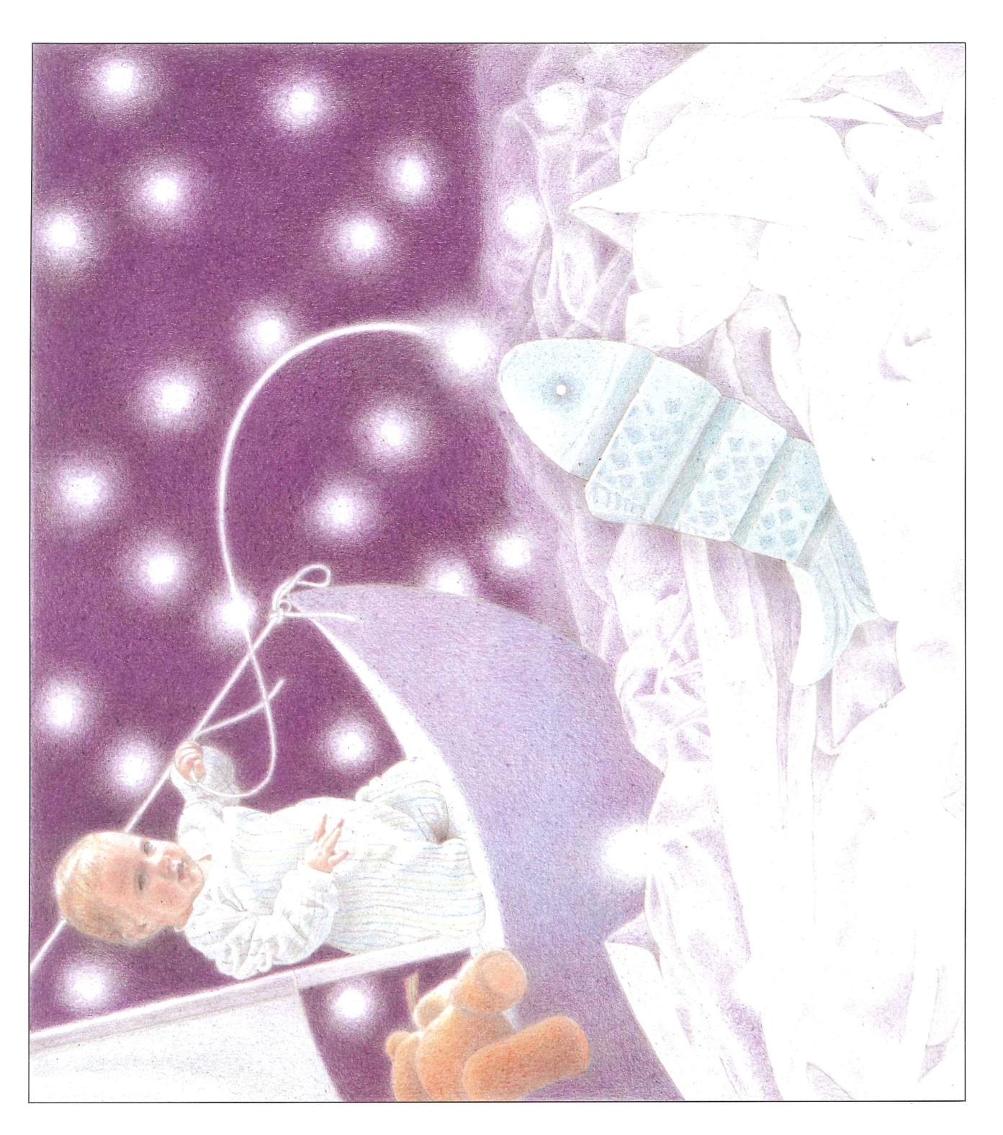

Slide 9
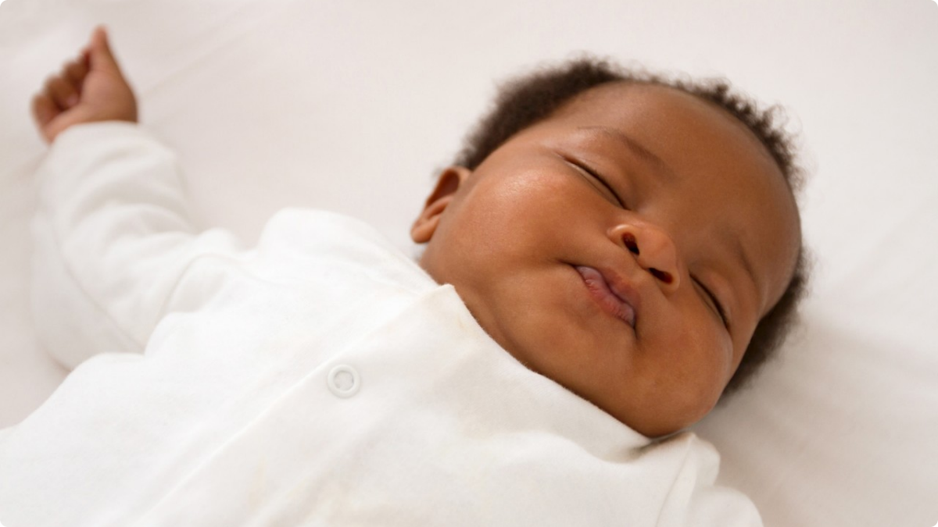
Shhh! The Baby’s Asleep now!

Slide 10
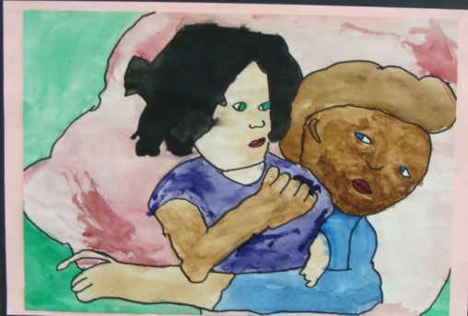
Lullaby
a soft gentle song sung to make a child go to sleep
She sang her baby a lullaby.

Slide 11
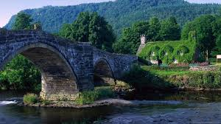
Ar Hyd a Nos
All Through the Night

Slide 12
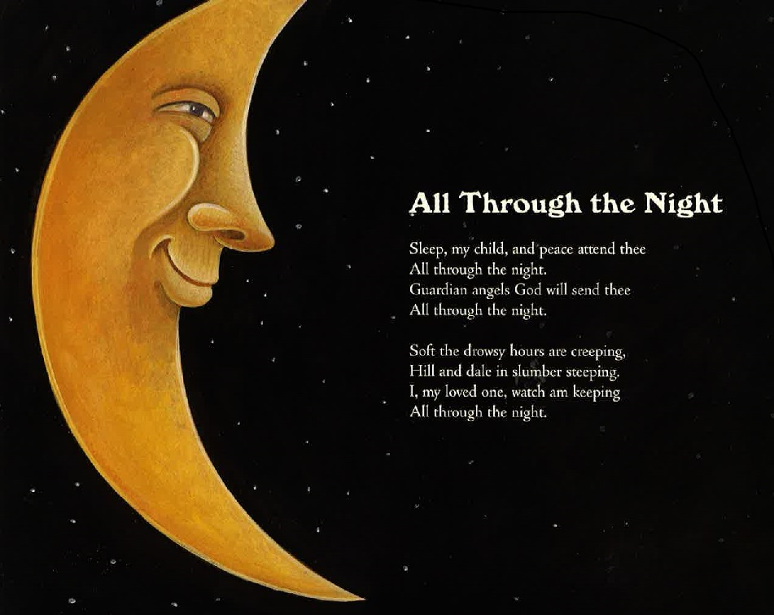

Slide 13
All through the Night
Sleep my child and peace attend thee
All through the night
Guardian angels God will send thee
All through the night.
Soft the drowsy hours are creeping
Hill and dale in thunder keeping
I my loving watch am keeping
All through the night

Slide 14
More Lullabies

Slide 15
All the Pretty Little Horses
Hush-a-bye, don’t you cry.
Go to sleepy little baby.
When you wake you shall have
All the pretty little horses.
Blacks and bays, Dapples and greys,
Coach and six a little horses.
Hush-a-bye, don't you cry, Go to sleep my little baby.
Hush-a-bye, don't you cry,
Go to sleep my little baby.
When you wake you shall have
All the pretty little horses.

Slide 16
Papa's gonna buy you a billy goat.
And if that billy goat won't pull,
Papa's gonna buy you a cart and bull.
And if that cart and bull turn over,
Papa's gonna buy you a dog named Rover.
And if that dog named Rover won't bark,
Papa's gonna buy you a horse and cart.
And if that horse and cart fall down,
You'll still be the sweetest little baby in town!
Hush little baby, don't say a word,
Papa's gonna buy you a mockingbird.
And if that mockingbird won't sing,
Papa's gonna buy you a diamond ring.
And if that diamond ring turns to brass,
Papa's gonna buy you a looking glass.
And if that looking glass gets broke,

Slide 17
South African Lullaby
Omo Elipse Arts 1999

Slide 18
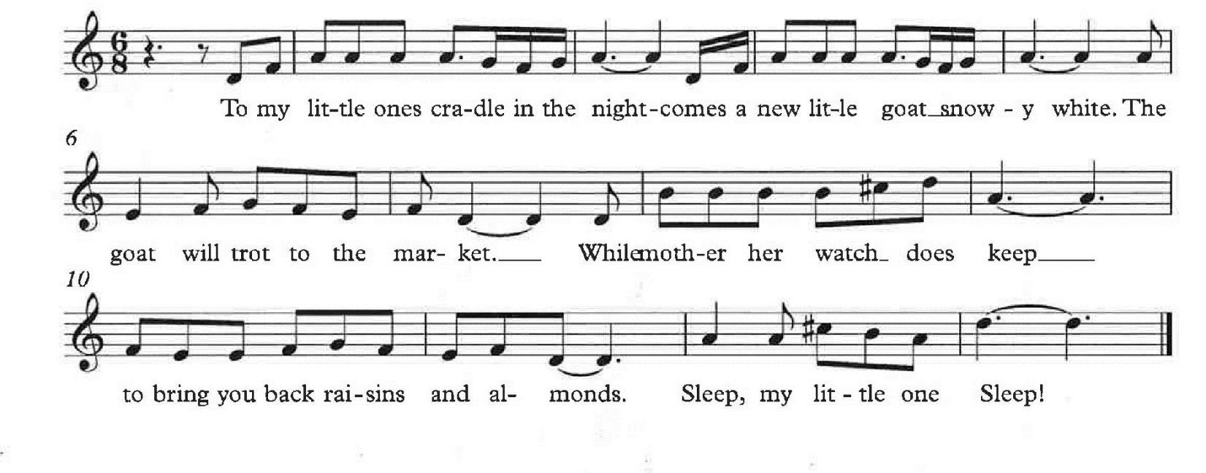

Slide 19
Notes:
The diverse Drew Community pre 2000. The American Dream Quilt and Lullaby Project. Washington Post. Arlington Foundation. George Mason Universty.

Slide 20
The Community
Our Neighborhood, Our County, Our World

Slide 21
Drew Students

Slide 22
Procedure
Learn lullabies
Make an interview plan
Gather Data
Share back what you found
Teach each other the new songs
Compile songs via Finale or Sibeilus
Write new Lullabies using: note writing software, or Orff instrumentation, or combination.
Teach each other the new compositions
Plan one or more culminating activities.

Slide 23
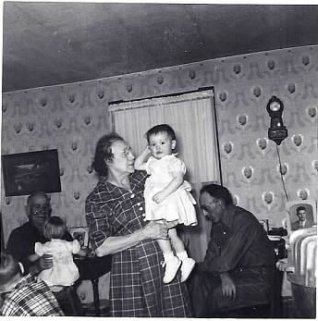
Ask the Right Question
Notes:
40 miles away. Humming a tuneless melody when rolling pie dough or rocking the baby. Smile a while.

Slide 24
Project Possibilities
Published Illustrated lullaby book
Published edited CD of sung lullabies
Performance event with cultural foods and dress
Small performances at local venues: Pre-school classes after lunch, Senior Citizens meetings, PTA, School Board.
Arts Integrated Project with individual Quilt piece representing your family or culture.
Mary Cassatt Style self portrait by students with their interview subject displayed with their
lullaby.

Slide 25
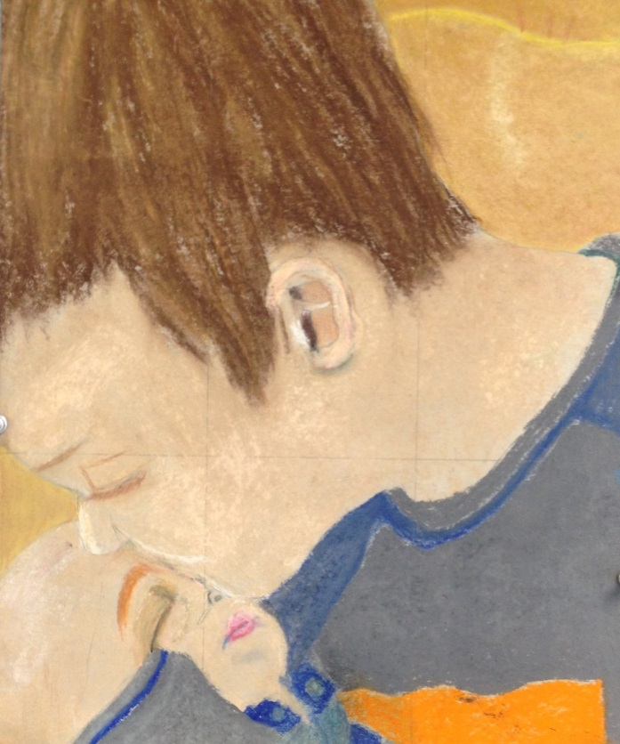

Slide 26
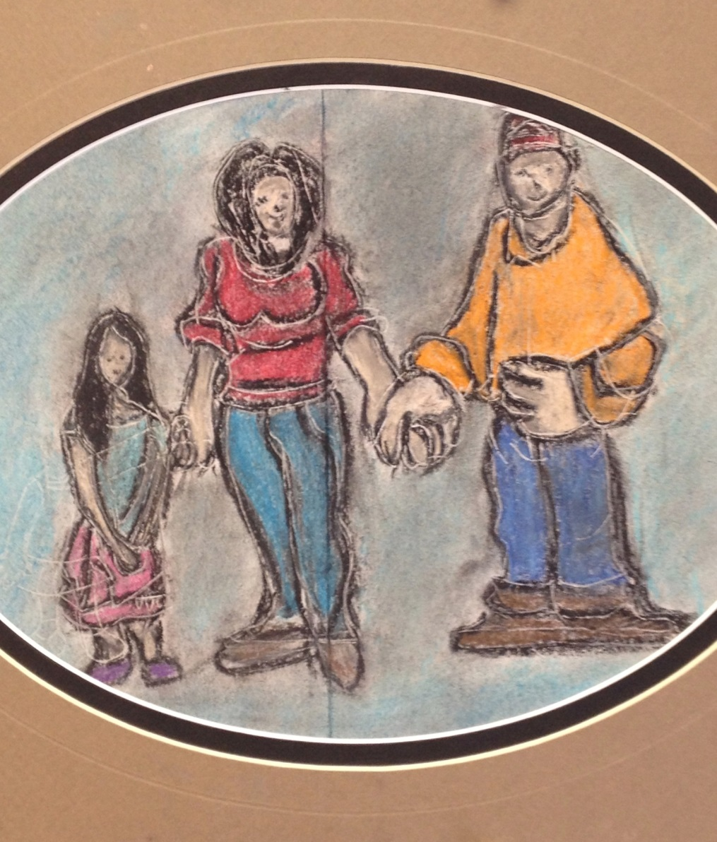

Slide 27
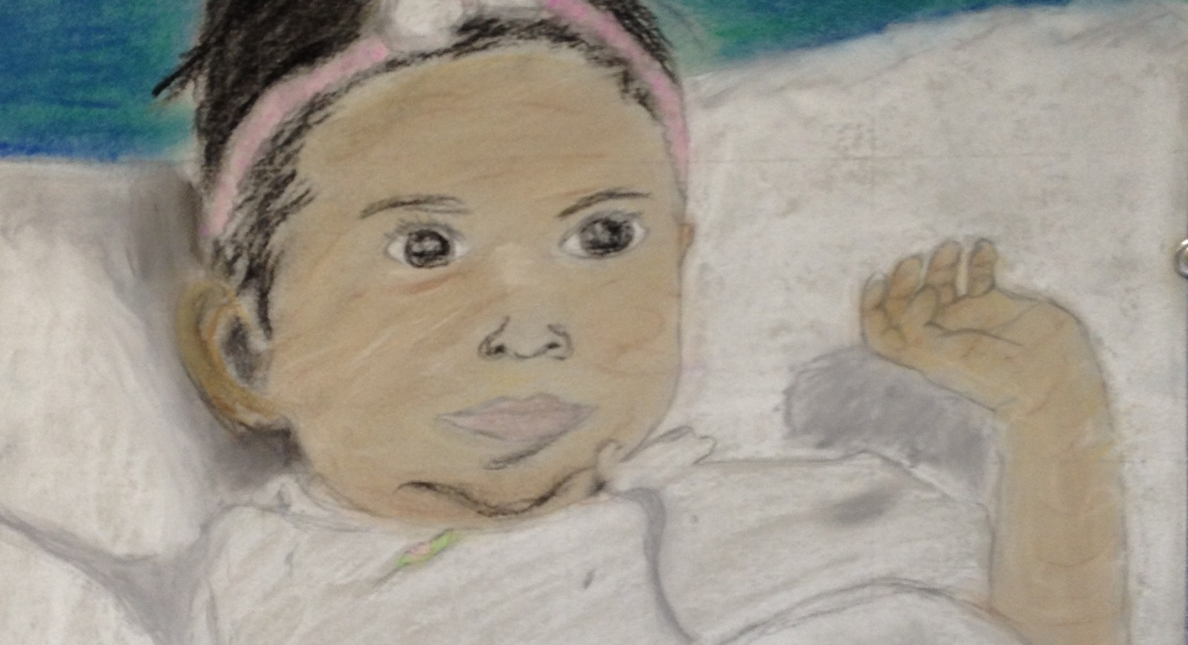

Slide 28
21st Century Applications
Your Community
Your social media outreach
Your technology infrastructure
Your demographics

Slide 29
Your Lullaby
Your Story

Slide 30
Will this change our community?
7-10 minutes
Call, ask or interview a family member
Ask a person at this conference
Or write a quick reflection about your own lullaby.
Be prepared to share out in about 12-15 minutes.

Slide 31
It’ll be ok, it’ll be all right I’m comin’ back.
Soldier Daddy writes a lullaby

Slide 32
References
Metropolitan Museum of Art. (1997) Lullabies. New York, NY: Gulliver Books.
Titherington, Jeanne. (1992) Baby’s Boat. New York, NY: Greenwillow Books.
Yarrow, Peter. (2008) Sleepytime Songs. New York, NY:Sterling Books
Yolen, Jane. (1986). The Lullaby Songbook. San Diego, CA: Harcourt Brace Javanovich Publishers.

Slide 33
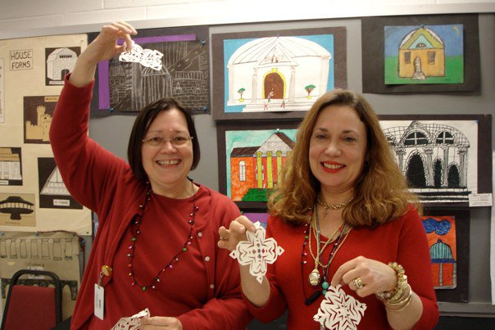
Thank You!
Connie Usova, Arts Educator, Arlington VA
Dr. Fran Austin, DoDEA/DDESS
Drew Model School Students Arlington VA
DDESS Students
Polly & Sophia McCann

Slide 34
Contact Information
Dr. Alice R. Hixson
703-304-8461
Alice.hixson@am.dodea.edu
alicehixson@yahoo.com

